Slide 1

Terms of Use
Notes:
Estimated time:
20 -25 minutes
Learning objectives:
Make new hires familiar with the core content of the terms of use
Proactively cover „What if customer calls-scenarios“ often coming from new hires and providing some security.
Facilitation:
Start the Power Point
Explain that you want to go through some customer scenarios and discuss what new hires think about what an appropriate reaction could be.
Each slide has an audio recording for the scene. Click on country flagof each customer to play it in English, German or French..
It‘s not the intention to do a roleplay. It is more a discussion comparing knowledge they might have from other companies and clarify the presented scene with our terms of use (each slide has a short explanation of the terms of use passage matching to each scene)
At the end tell that these situations rarely will happen and that they also were exaggerated
Guide them to the Terms of use where they can read more about it.

Slide 2






Notes:
Agreement/Acceptance of Terms and conditions
As soon as a customer accesses or uses the Vistaprint Site, they automatically accept the Terms of Use. There may be changes at any time to the Terms of Use without prior notice. Customers should review these Terms of Use each time they access this Site
Scene1:
“I quickly went through your terms of use and read that you can delete designs from time to time. That happened in my case now. There was never a question I had to checkmark to accept the Terms of use”
"Ich habe Ihre Nutzungsbedingungen durchgesehen und gelesen, dass Sie Designs von Zeit zu Zeit löschen können. Das ist in meinem Fall jetzt passiert. Es gab nie eine Frage, die ich ankreuzen musste, um die Nutzungsbedingungen zu akzeptieren".

Slide 3



Notes:
Limitation of Liability
Should the site, products or services provided by Vistaprint be used for illegal or inappropriate purposes, the user alone is responsible.
Customer’s inquiry:
Scene 3:
“One of my customers showed me a flyer from one of my competitors and on there is a huge remark saying that his cake is far better and way healthier than mine. Such declarations are illegal, and you have printed them anyway! I’ll better ask my lawyer!”
"Einer meiner Kunden zeigte mir einen Flyer von einem meiner Konkurrenten und darauf steht eine riesige Bemerkung, dass sein Kuchen viel besser und viel gesünder ist als meiner. Solche Aussagen sind illegal, und Sie haben sie trotzdem ausgedruckt! Ich frage besser meinen Anwalt!"

Slide 4


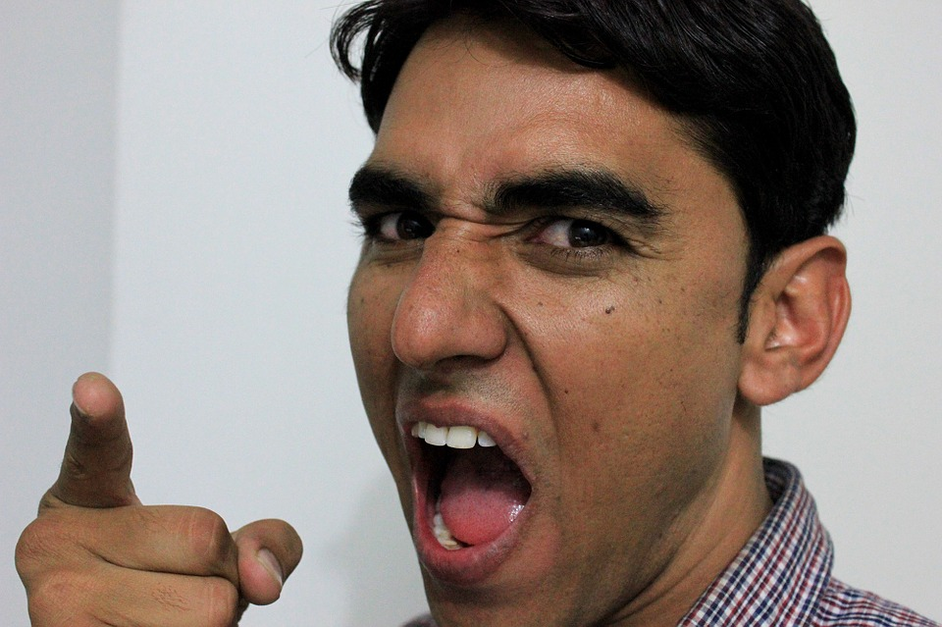
Notes:
Transfer of Title
Vistaprint will not be liable for any delays or damages once the goods have been delivered to the shipper. This applies to all customers. Once a private customer has received the goods, the customer accepts the condition on delivery.
Scene 4:
“I have ordered some presentation folders and wanted to use them to fill it with information about my company at the fair tomorrow. Now I have received them totally destroyed and can’t use them. I will make you liable for it!”
"Ich habe einige Präsentationsmappen bestellt und wollte sie morgen auf der Messe mit Informationen über mein Unternehmen füllen. Jetzt habe ich sie völlig zerstört erhalten und kann sie nicht mehr verwenden. Ich werde sie als Firma dafür haftbar machen!"

Slide 5


Notes:
Site feedback
If the user makes comments or feedback about the Site, Vistaprint may use such comments or feedback without limitation.
Scene 5:
“I was shocked when I recently browsed through face book. I saw my product feedback which I shared on your website. I have never allowed you to post it on your face book page!”
"Ich war schockiert, als ich kürzlich bei Facebook surfte. Ich habe mein Produktfeedback gesehen, das ich Ihnen auf Ihrer Website mitgeteilt habe. Ich habe ihnen nie erlaubt, es auf ihrer Facebook-Seite zu veröffentlichen!"

Slide 6



Notes:
Use of the site / Indemnification
The user/customer agrees that s/he is soley responsible for using the Vistaprint content (images, text, designs) according to law. They also agree not to use content from third parties unless they have a lisence or permission.
Plus, they are not allowed to send E-Cards with Vistaprint content and have the responibility to protect their passwords to their Vistaprint accounts.
Customers agree to indemnify Vistaprint and all parties from whom Vistaprint has licensed portions of Content against all claims, liability, damages, costs and expenses arising out of or related to any breach of these Terms of Use. Customers also agree that we have the right to control the defense of any such suit, claim or demand.
Scene 6:
„I am desperate! I have bought a banner for my restaurant and a lawyer from Coca Cola wrote a letter wanting me to pay 5.000 $ because I have used their logo on the banner. You should have known that, cancel the production and inform me about it. You have a responsibility for your customers!
"Ich bin verzweifelt! Ich habe einen Banner für mein Restaurant gekauft und ein Anwalt von Coca Cola schrieb einen Brief, in dem er mich aufforderte, 5.000 $ zu zahlen, weil ich deren Logo auf dem Banner verwendet habe. Sie hätten das wissen, die Bestellung stoppen und mich informieren müssen. Sie haben eine Verantwortung gegenüber ihren Kunden!“

Slide 7
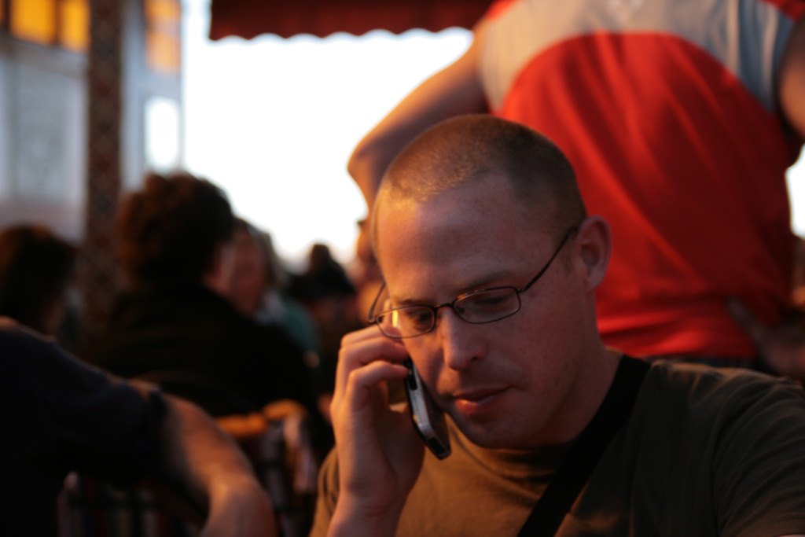

Notes:
Disclaimer of Warranty
The user accepts errors and omissions on the website. The Vistaprint Satisfaction Guarantee is valid for 10 years from the date of purchase.
Customer’s Inquiry:
NB: Highlight that certain circumstances are beyond Vistaprint´s control and may not be covered by the Satisfaction Guarantee. In addition, that we cannot be responsible for: Spelling, punctuation or grammatical errors, poor resolution image uploaded by the customer etc.
Scene 7:
“Three years ago, I have ordered a mug with the wedding picture of me and my wife on it and now the image has become faded more and more. I am not satisfied and want a new one.”
"Vor drei Jahren habe ich eine Tasse mit dem Hochzeitsbild von mir und meiner Frau darauf bestellt und jetzt ist das Bild immer mehr verblasst. Ich bin nicht zufrieden und will eine neue Tasse."

Slide 8


Notes:
Governing Law
Vistaprint is headquartered in Venlo, The Netherlands. Dutch laws apply. If the customer wishes to sue Vistaprint, they must first do so in Amsterdam.
Scene 8:
“I am a lawyer and like to know where your company has its headquarters so that I know which court is responsible.”
"Ich bin Anwalt und möchte wissen, wo Ihr Unternehmen seinen Hauptsitz hat, damit ich weiß, welches Gericht zuständig ist."

Slide 9


Notes:
Payment methods (not for all countries but for DACH and BENE)
The amount of an order will be charged in advance, before Vistaprint will print products. In case that Vistaprint doesn‘t get the money a warning will be sent via Email. If there is no reaction then Vistaprint has the right to forward the case to a debt collection agency. In case that Vistaprint cancels an order the payment goes directly back to the payment method the customer used.
Scene 9
What are you doing? I recently ordered from you and was surprised that you immediately charged my credit card. I won't pay until I have the goods. Anyway, my order came and shortly after I received a warning from a debt collector. Didn't you charge my card when you shipped my order? Anyway, instead of 10 EUR/ pounds, I have to pay three times as much. I will never order from you again.
Right to withdrawal (UK)
The legal right to withdraw from the agreement with us (also called the legal right to cancel the order) within 14 days does not apply to the order of a customized Product. In relation to any of the non-customid Products you have ordered from the Site and those products or services do not attribute to your commercial or practical practice, you have a period of 14 days to withdraw from the agreement with us without giving any reason. The withdrawal period of 14 days will expire after 14 days from the day on which you receive the Products
Note for the trainer: What the customer didn‘t say is that she bounced the payment after she noticed that the payment was charged before shipping. This is something for you to add that many customers don‘t say this and thats important to check.

Slide 10



Slide 11

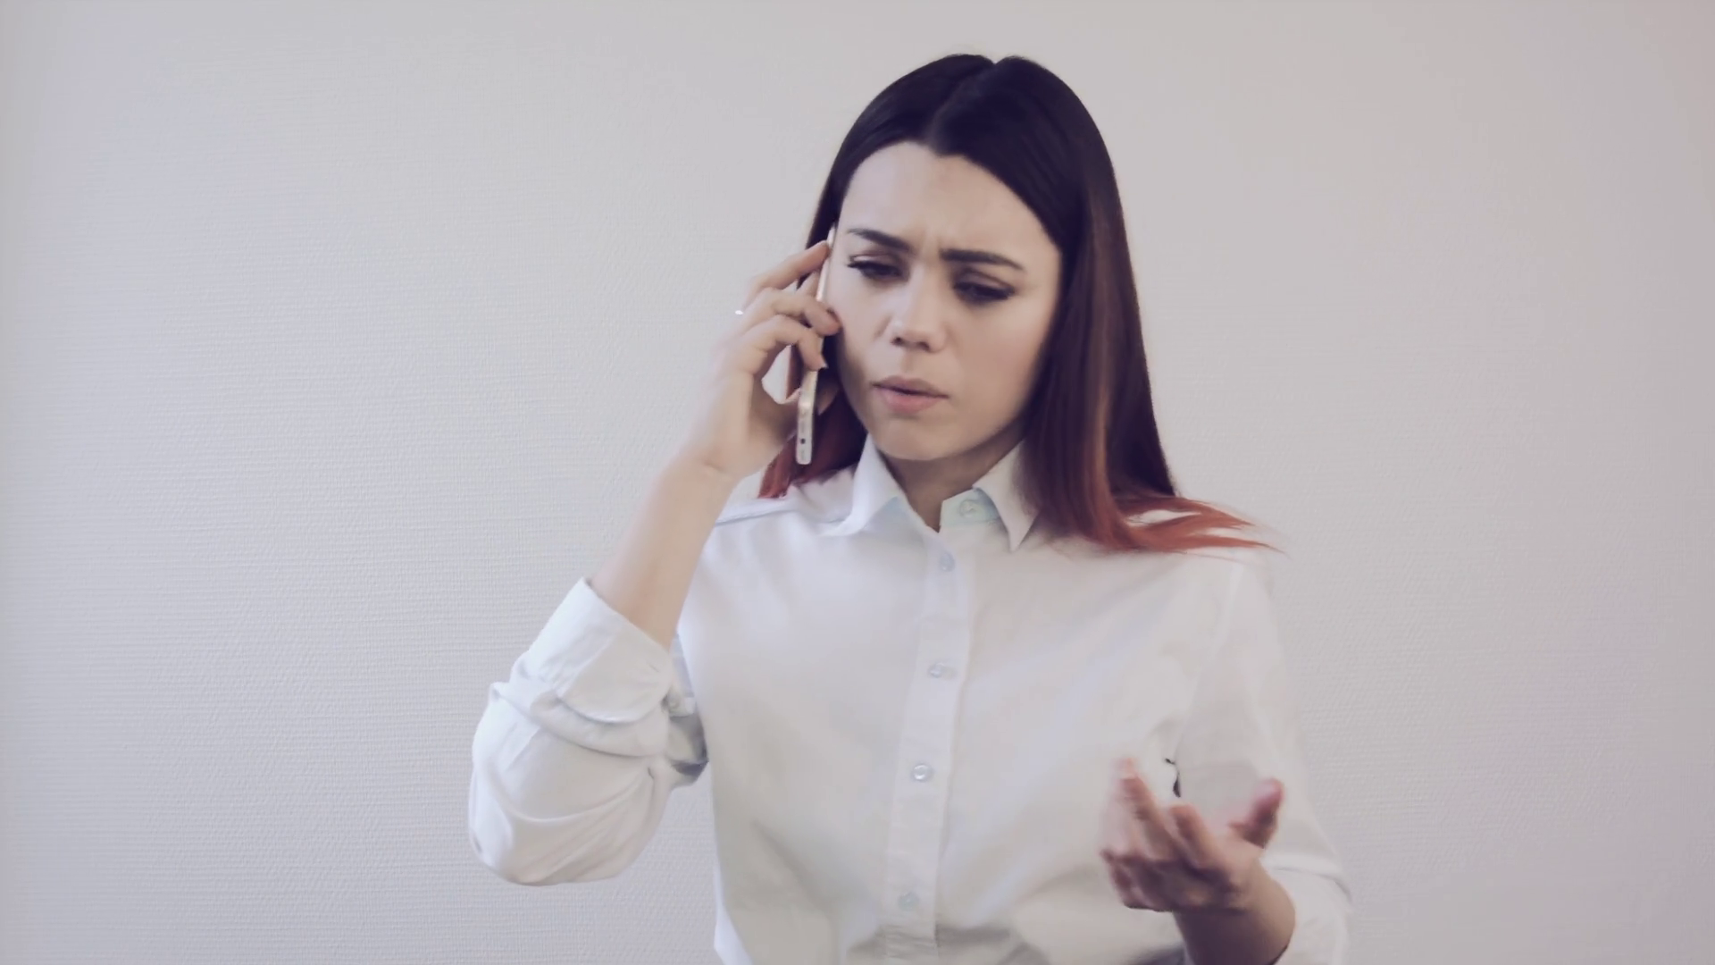
Notes:
(EU) What is GDPR & to whom does it apply to?
The General Data Protection Regulation or GDPR is a European-wide regulation that replaces the existing Data Protection Directive. It regulates how companies collect, use, and transfer personal information of EU citizens, data security and breach notification, and the rights people have with regard to their own personal data. The GDPR is effective as of May 25, 2018. GDPR applies to anyone that resides in the EU who places an order on any of the EU sites of Vistaprint, including Switzerland (CH). Our NA websites (.com and .ca) are not directed at EU customers and therefore fall outside of the scope of the GDPR.
Scene 11
I want to close my Vistaprint account and must insist that you delete every single personal information you may have collected since my account was created on your website.
Note for the trainer: Explain the difference between account deactivation Vs account deletion.
Direct trainees to the GDPR article found under the Vistaprint Help section ?

